Slide 1
Key aspects of the Irish labour market - challenges and opportunities
Fiona Higgins, Senior Manager Ibec
Zagreb 31 May 2017

Slide 2
Agenda
Ibec
Policy issues for Irish business 2017
  Brexit
  International Reputation
  Investment & Infrastructure
The Irish Labour Market

Slide 3


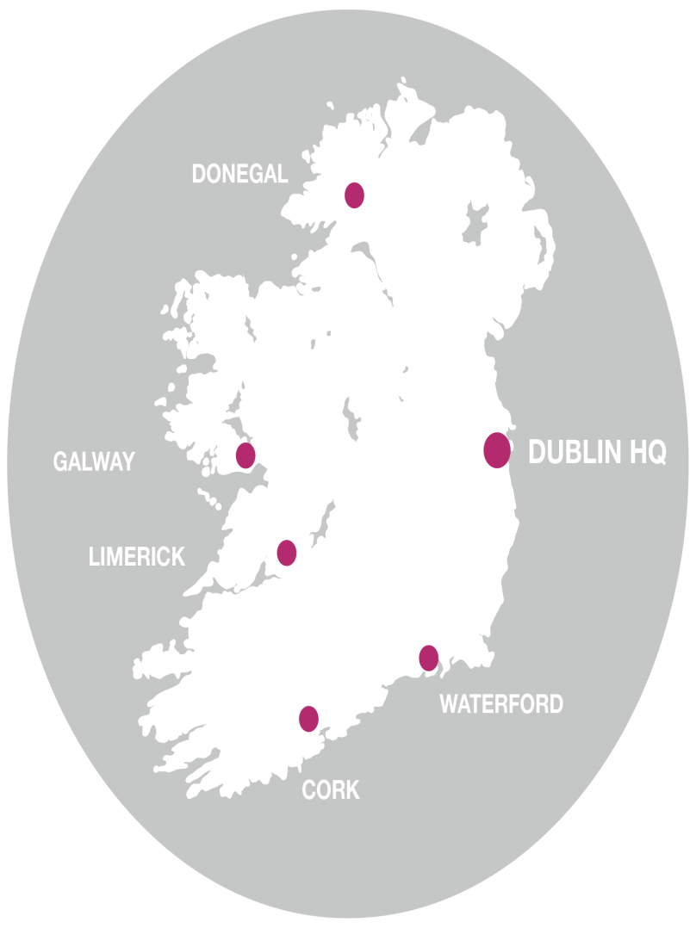
^{Ibec is the largest and}
^{most influential}
^{business}
^{organisation}
^{in Ireland.}
Key aspects of the Irish Labour Market - challenges and opportunities

Slide 4
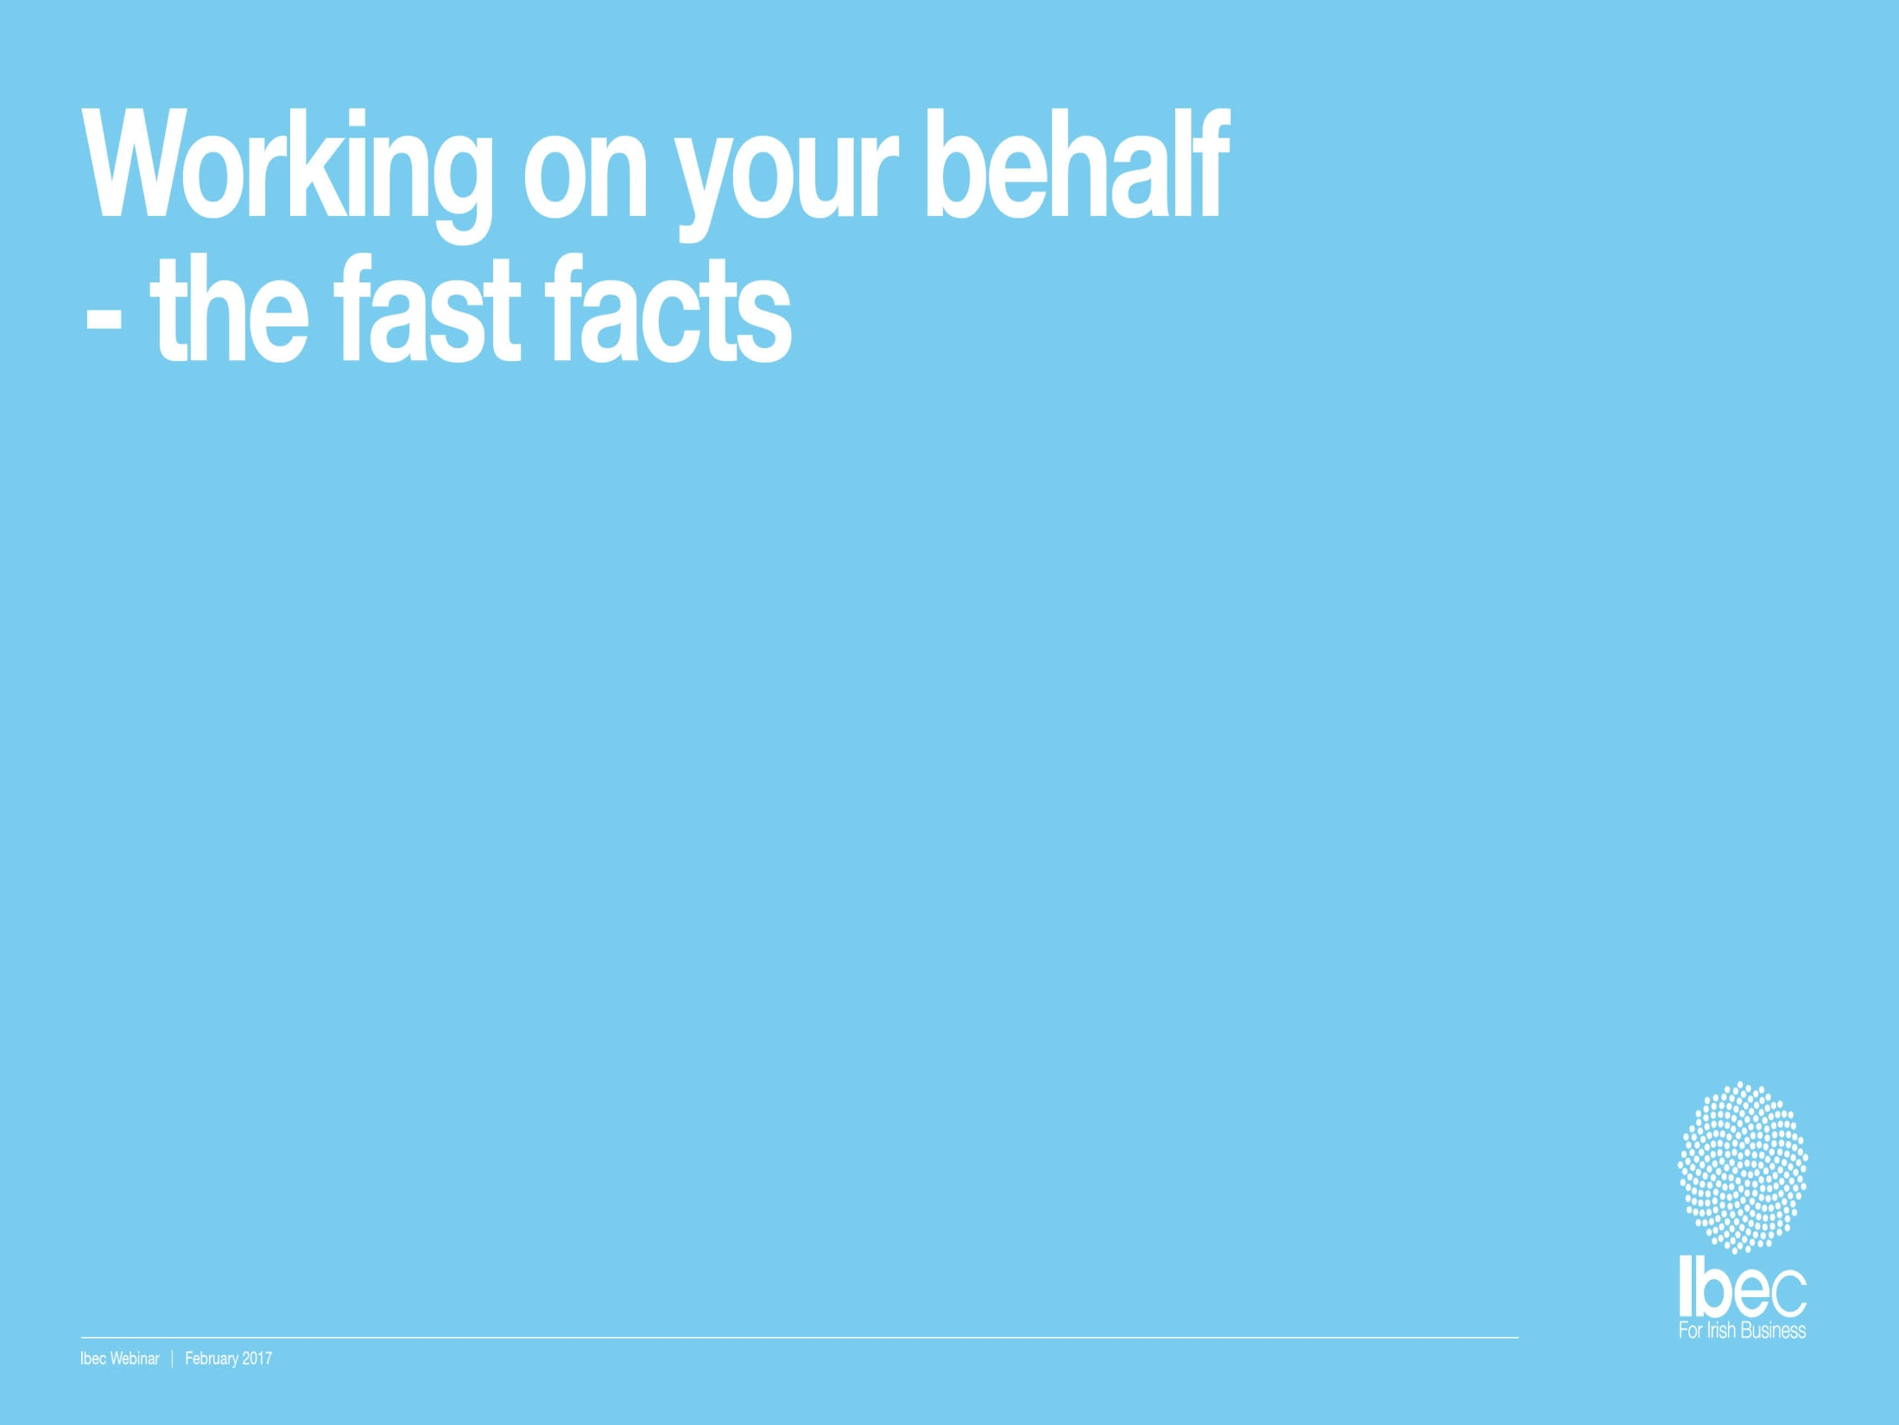


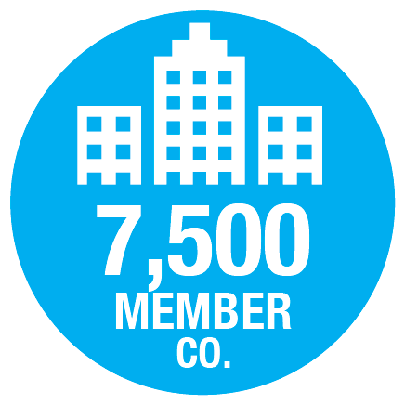






Key aspects of the Irish Labour Market - challenges and opportunities

Slide 5















Our 40+ business sectors representing all industries

Slide 6
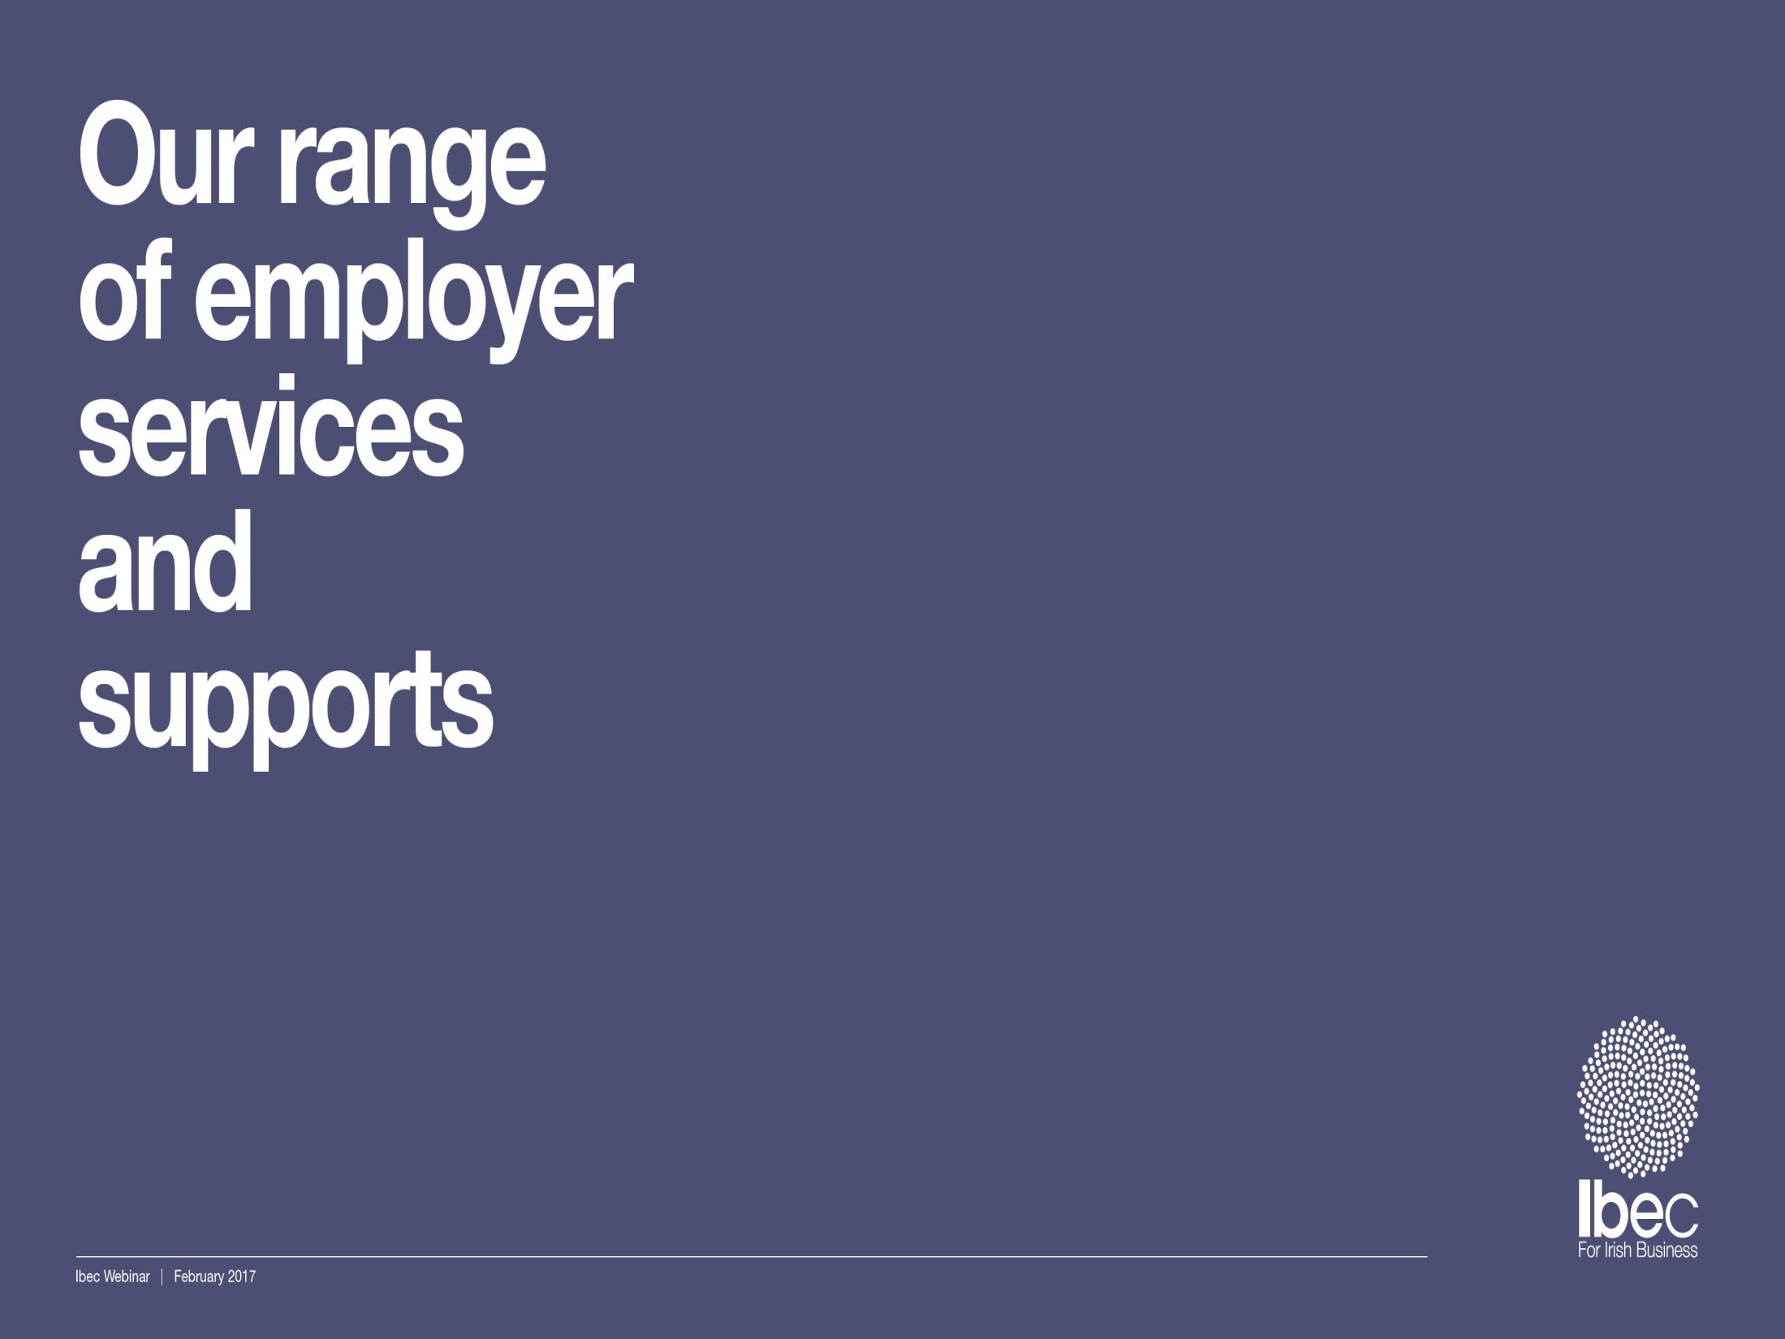







^{Expertise and} ^{support on:}
^{Brought to you via:}
^{Legal Representative}
^{Services}
^{Occupational Health &}
^{Safety}
^{Employment Law}
^{Knowledge Centre}
^{Industrial}
^{Relations}
^{Online HRM Guide}
^{HR Best Practice}
Key aspects of the Irish Labour Market - challenges and opportunities

Slide 7
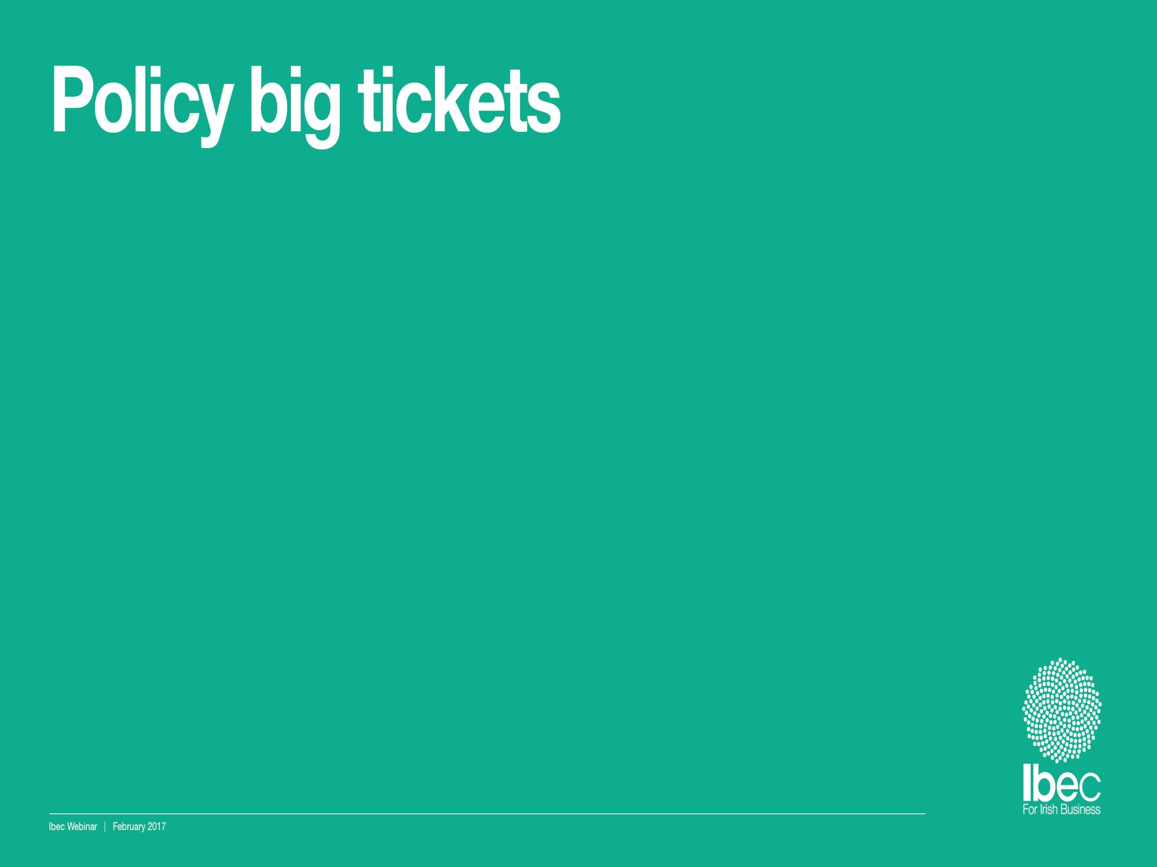



Brexit support with a domestic policy response
Ireland’s International Reputation
^{Investment & Infrastructure}
Key aspects of the Irish Labour Market - challenges and opportunities

Slide 8
Brexit support with a domestic policy response
Key aspects of the Irish Labour Market - challenges and opportunities

Slide 9

Ibec Brexit Campaign 2017
Identify member challenges
Support contingency planning
Engage, influence and shape outcome
Communicate and profile campaign work

Slide 10
Policy and engagement plan
Identify headline and detailed sectoral issues
Set out business domestic / EU positions
Comprehensive engagement plan:
  Government, opposition, agencies
  UK Government, UK Embassy, NI Assembly
  EU Council, Commission, Parliament
  EU Member States
  European business

Slide 11
Brexit Toolkit for Business www.ibec.ie

Slide 12
Ireland’s International Reputation
Key aspects of the Irish Labour Market - challenges and opportunities

Slide 13
The substance behind Ireland’s success
Through EU membership and the embracing of globalisation, Ireland has been catapulted from a small island nation with low economic activity, to a highly competitive country with some of the world’s highest living standards. Ireland’s support of the Europe Single Market and the internationalisation of business have been transformative for the Irish business community.
The OECD Base Erosion Profit Shifting (BEPS)corporate taxation process has been a crucial advantage for Ireland.
Underpinning the business model is a 12.5% corporate tax rate, the second lowest in the EU but applied to a wide base. It is part of a multifaceted package of measures that are attractive to globalised businesses

Slide 14
The substance behind Ireland’s success
Population of 4.6m
Fastest growing population in Europe with the island expected to reach 10 million people by 2050 with more than half the population under the age of 35
Youngest and most highly educated workforces in the world according to the OECD
Over half of 25-34 year olds have a third level qualification

Slide 15
Key Messages
Ireland is home to all of the top ten global technology companies and 18 of the world’s top 20 pharmaceutical companies
Six of the world’s top selling pharmaceutical products are produced in Ireland
Ireland’s food and drink sector is the largest net exporter of dairy ingredients, beef, and lamb in Europe
Ireland manages half of the worlds' leased aircraft
Half of hospital ventilators worldwide are manufactured in Ireland

Slide 16
www.politico.eu

Slide 17
^{Investment & Infrastructure}
Key aspects of the Irish Labour Market - challenges and opportunities

Slide 18
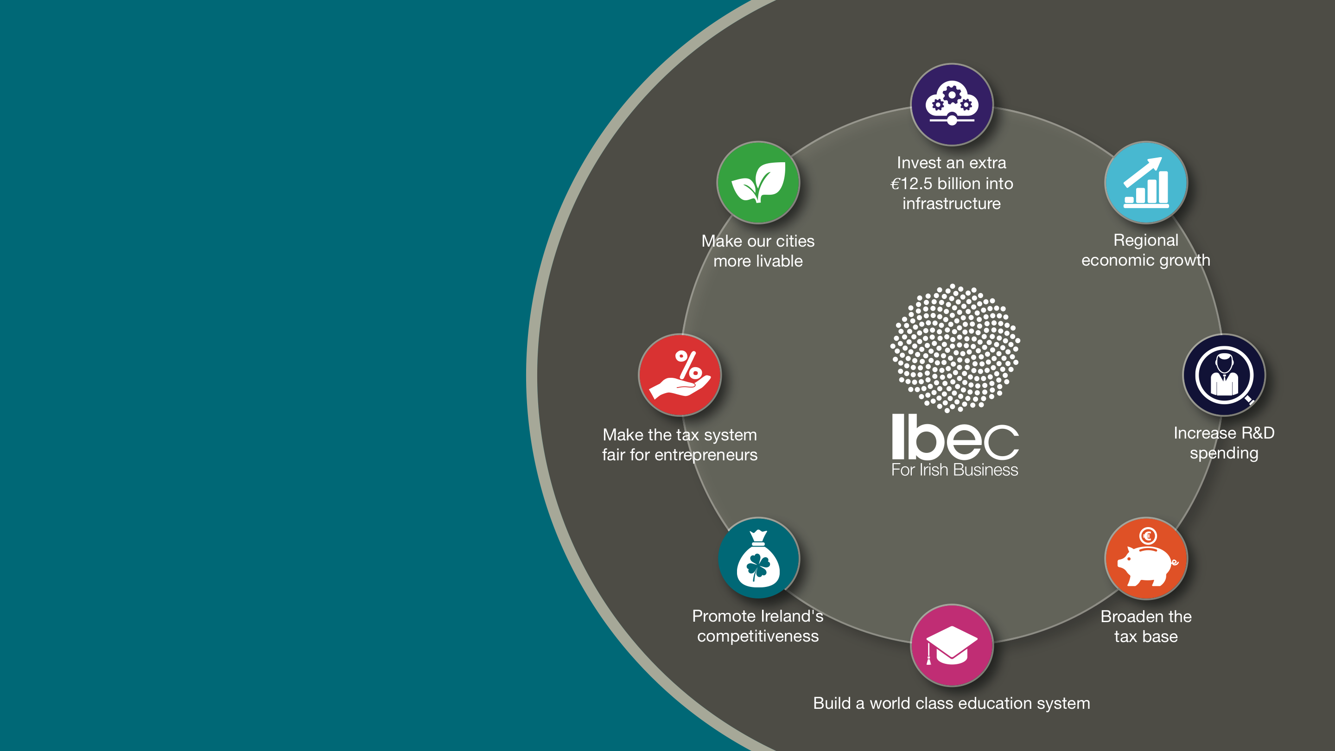
Acting as our members voice in addressing
key business
and policy
issues
Notes:
We work with members to develop policy in key areas of interest – from shaping an agile flexible labour market to promoting ambitious investment in critial public infrastructure and education systems. Through our close working relationship with key policy makers, government departments, state agencies, we ensure those interests stay at the top of the political agenda

Slide 19
Unemployment has fallen rapidly
Unemployment now down to 6.6%.
Crucially short-term unemployment now below its pre-crisis peak
Total employment will return to 2006 levels by the end of 2017with employment growth approaching 2.4% for the full year

Slide 20
Employment strong in all but 6 sectors
As it stands all but 6 sectors of the economy have returned to their 2007 peaks in terms of employment
Only in retail industry and most construction is employment below its pre-crisis peak

Slide 21
Narrative of ‘low pay’ Irish employment largely a myth
Ireland has a minimum wage which is amongst the highest in the developed world and tax rates on low earners are among the lowest in the developed world
As a result the number of hours needed to be worked at the minimum wage in Ireland in order for a worker to exit poverty is the second lowest in the OECD.
Number of Hours Worked at Minimum Wage to exit Poverty, excluding Social Assistance Benefits, 2013

Slide 22
Industrial Relations
Insight into labour market issues at the level of the company
Stable industrial relations climate
High level social engagement
  Eg Labour Employers Economic Forum (LEEF)
  Public Sector Agreements
Effective dispute resolution mechanism in the Workplace Relations Commission (WRC)

Slide 23
Industrial Relations
High labour costs/wage demands threaten competitiveness
High profile disputes involving pay claims in excess of market rates
High rate of tax impediment to attracting key skills and talent
Over-regulation of the employment contract and relationship

Slide 24
Over-regulation of the employment contract
Minority Government supported by the opposition
Unprecedented number of non government proposed legislation
  Examples; Industrial Relations (Right of Access) (Amendment) Bill 2016
  Protection of Employment (Uncertain Hours) Bill 2016
  Banded Hours Contract Bill 2016
  Terms of Employment (Information) (Amendment) and Organisation of Working Time (Amendment) Bill 2016
Less than 1.8% of workforce on low hours
No impact assessment of proposals
Unintended negative consequences for employers

Slide 25


Slide 26

Thank you

